Slide 1

Deep Learning
Minor part 2
Vera Hollink
2025

Slide 2
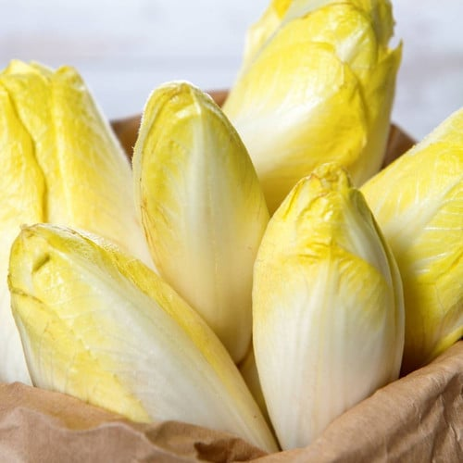


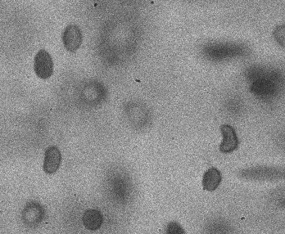
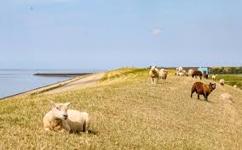
Course structure
Term 3
Foundational theory
Assignments
Term 4
Advanced theory
Student presentations
Deep Learning Project

Slide 3
Assessment
Foundations of Deep Learning - Exam
4 EC end of term 4
multiple choice exam
Foundations of Deep Learning - Assignments
8 EC during term 3
3 assignments (average grade)
Applications of Deep Learning - Presentations
3 EC during term 4
student presents a paper
Deep Learning in action
15 EC during term 4
group project

Slide 4

Schedule part 2
Tuesday:
Project work
Lecture / student presentations
Thursday:
Project work
Lecture / guest lecture
Exact schedule in the course guide

Slide 5

Projects
Weekly standup on Tuesdays
Deadlines (Moodle)
Draft report Sunday May 18
Final report and code Sunday June 1

Slide 6
Student presentations
Content: read scientific paper
Application of deep learning
Technical: what type of model
Results
Scientific journal or conference
At least 6 pages
Paper needs to be approved 1 week before presentation
Structure
Individual
Each student different paper
15-20 minutes presentation
5 minutes questions
Assessment form on Moodle
Time slots
3x May 6
3x May 13
3x May 20
3x May 27

Slide 7

Questions?

